Slide 1


MODELING A LOGISTIC
REGRESSION TO PREDICT CLICK ON Ads
PRESENTER:
MIZANUR RAHMAN
Department Of
Computer Sci & IT
DEC 3, 2019
Replace with
your Logo
Notes:
This file presents an assertion-evidence template for making effective slides for scientific presentations. Although much about the layout and typography contrasts sharply with the defaults of PowerPoint, these changes are done so to make the slides more effective at communicating technical information. The design advocated by this template arises from Chapter 4 of The Craft of Scientific Presentations, 2nd edition (Springer, 2013). The homepage for this template exists at the following website:
http://writing.engr.psu.edu/assertion_evidence.html
Right now you are viewing the notes pages. To work on the slides, click on “Slide” under “View.” Tip: When creating a new presentation, save this file as the name of your presentation. Warning: You are more than welcome to use this template for your presentation slides. You may not, though, distribute this template for profit or distribute this template without giving credit to the source: http://writing.engr.psu.edu/
This slide is for the title slide of a presentation. Consider inserting an image that helps orient the audience to the title. You should not leave this slide until the audience feel comfortable with the title. Forcing yourself to spend more time with this slide is good because a common mistake in presentations is to leave the title slide too soon. Because of this mistake, many in the audience do not have the chance to comprehend the key details of the title. See pages 172-184 in The Craft of Scientific Presentations, 2nd ed. (CSP).
This template shows one layout for the slide. You might want to rearrange the placement of the body’s wording to accommodate a different sized image. On the next slide is a sample title slide. You should delete the examples after you create your own slides.

Slide 2

OUTLINE:
Introduction
Logistic Regression
Confusion Matrix
Objective
Model Objective
Advertising.csv
Exploratory Data Analysis
Model
Predictions and Evaluation
Conclusion

Slide 3
INTRODUCTION:
LOGISTIC REGRESSION:
Is a classification technique that is used when the dependent variable is a categorical variable.
In ML and Statistics, Classification is the process of identifying to which of a set of category a new set of observation belongs to based on the training data.
The result of the classification into binary category(0 or 1) forms the basis of our predictions.
Some examples of classification problems are:
Spam VS "Ham" emails
Loan Default(YES/NO)
Disease Diagnosis(+ve/-ve)
CONFUSION MATRIX:
We will evaluate our logistic regression model using a confusion matrix. Its a table that is often used to describe the performance of the classification model on the set of test data.
The accuracy, sensitivity, and specificity can be good indicators of our model and what we want to do with our model. We will concentrate more on TRUE POSITIVES(TP) or FALSE NEGATIVES(FN). Also, you can use precision and recall and use the F1 to evaluate our model.

Slide 4

CONFUSION MATRIX cont’d
Imagine testing for a disease:
NO/FALSE = Negative Test = 0
YES/TRUE = Positive Test = 1
Terminologies:
True Positives (TP)
False Positives (FP), same as Type I Error.
True Negatives (TN)
False Negatives (FN), same as Type II Error.
Accuracy:
$\frac{(TN+TP)}{n}$ = $\frac{150}{165}$ = 0.91
Misclassification Rate(Error Rate):
$\frac{(FN+FP)}{n}$ = $\frac{15}{165}$ = = 0.09
n = 165 | Predicted: NO | Predicted: YES
Actual: NO | TN= 50 | FP= 10
Actual: YES | FN= 5 | TP= 100

Slide 5
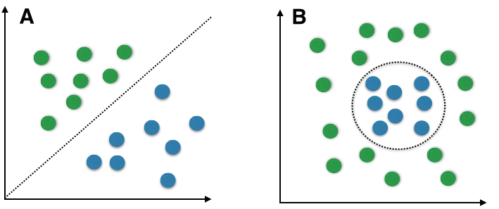
MODEL OBJECTIVE:
Our basic objective of this project is to predict from the result of our binary classification whether an internet user will click on advertising Ads.

Slide 6
Our Data Set
Target Variable
Clicked on Ad
Predictor Variables
Daily Time Spent on Site
Age
Area Income
Daily Internet Usage
Ad Topic Line
City
Sex(Male)
Country
Timestamp
Data Source: https://www.kaggle.com/logistic_regression/advertising
The data was collected and deposited on Kaggle by the founder and Head of Data Science at Pierian Data Inc., Jose Portilla.
The dimension of the data is 1000 by 10, indicating 1000 observations and 10 columns of variables.

Slide 7
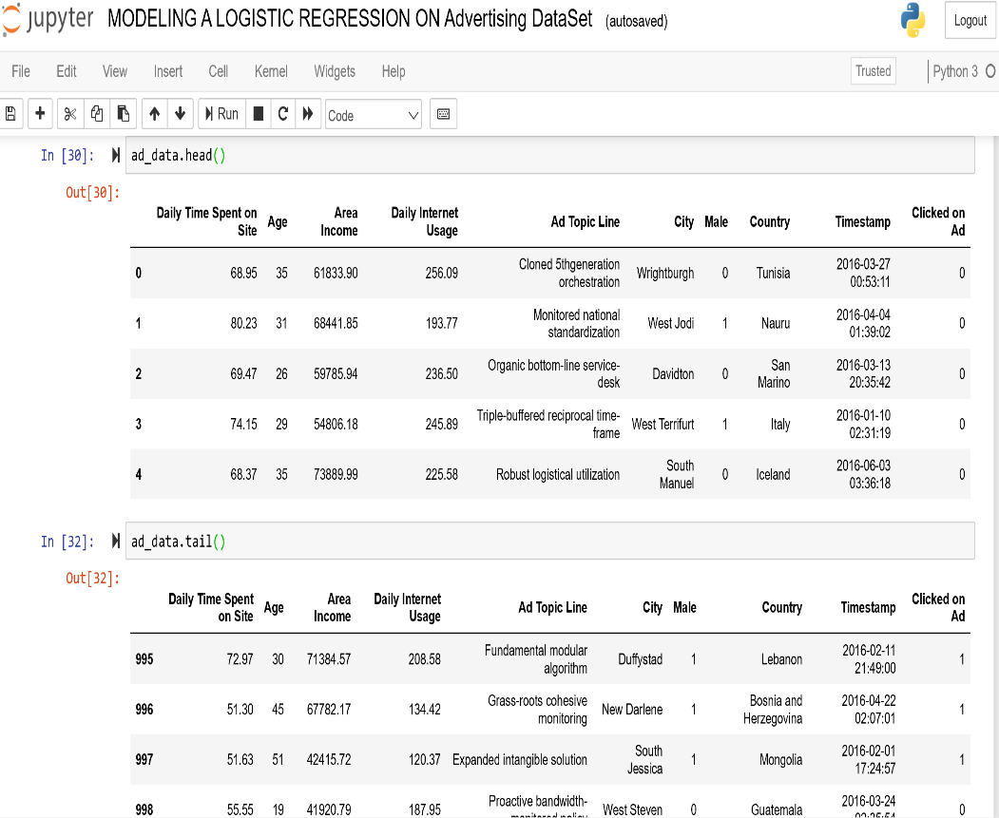
Our Data Set Cont’d
The dependent variable, Click on Ad and other variable like sex, are categorical variable which were both processed into binary category of 0 and 1, with 0 representing NO/female and 1 representing YES/male as the case may be.

Slide 8
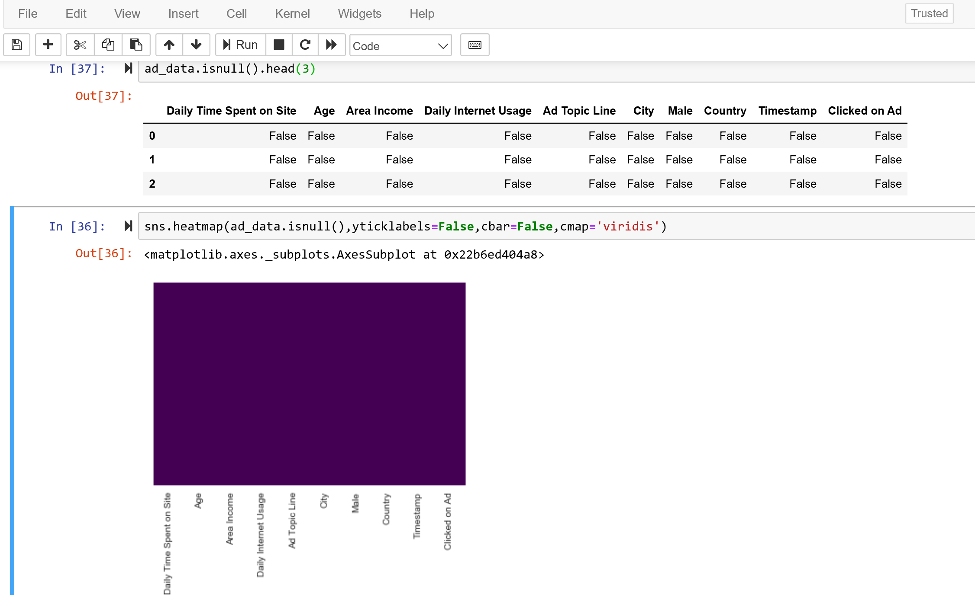
EXPLORATORY DATA ANALYSIS
The dependent variable, Click on Ad and other variable like Sex, are categorical variable which were both processed into binary features of 0 and 1, with 0 representing NO/female and 1 representing YES/male as the case may be.
Male = pd.get_dummies(ad_data[‘Sex’], drop_first = True)
After cleaning our data, we check to confirm that there are no missing values left(ad_data.isnull()), we visualize this with heatmap.

Slide 9
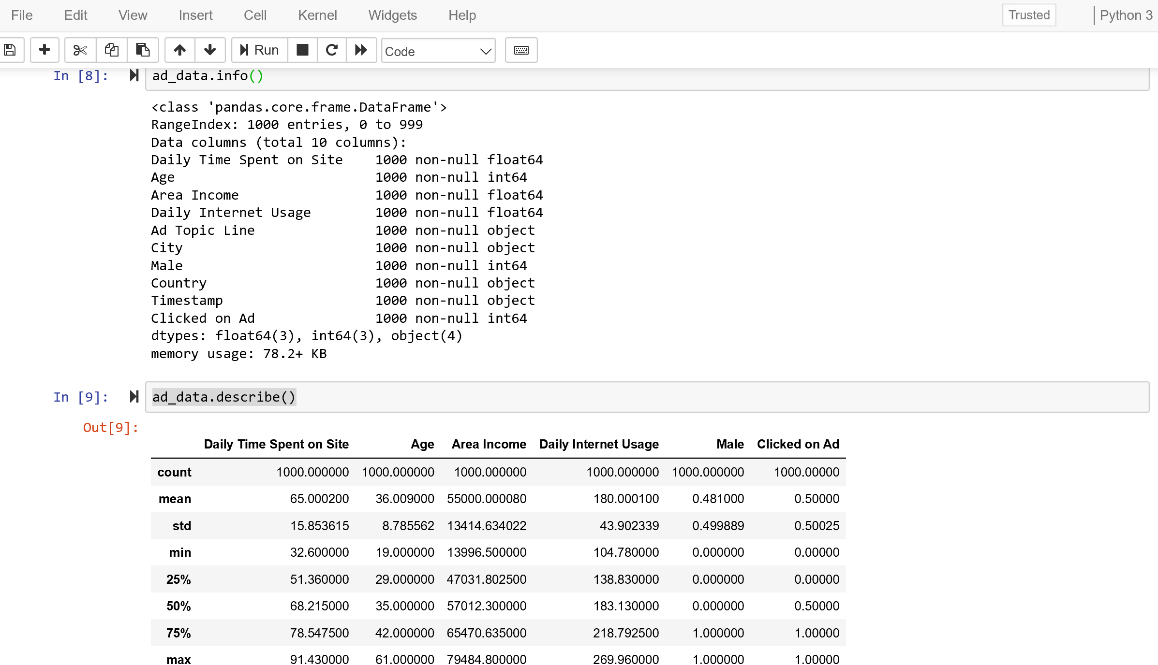
DATA EXPLORATORY Cont’d

Slide 10
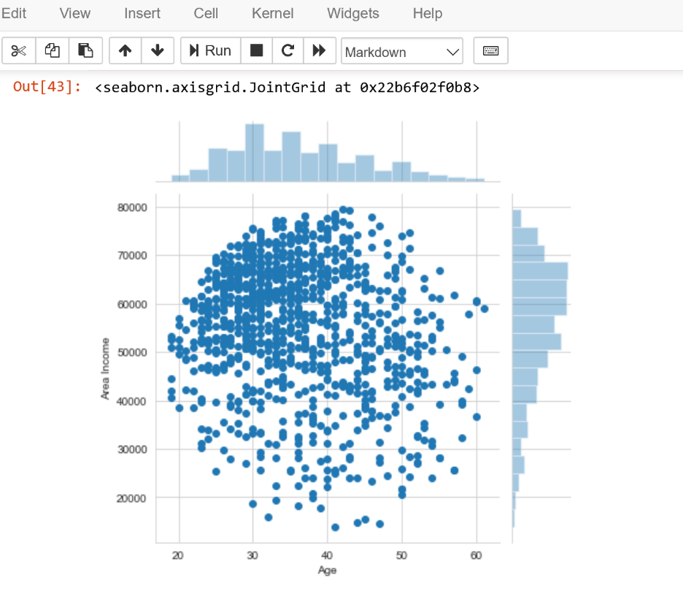
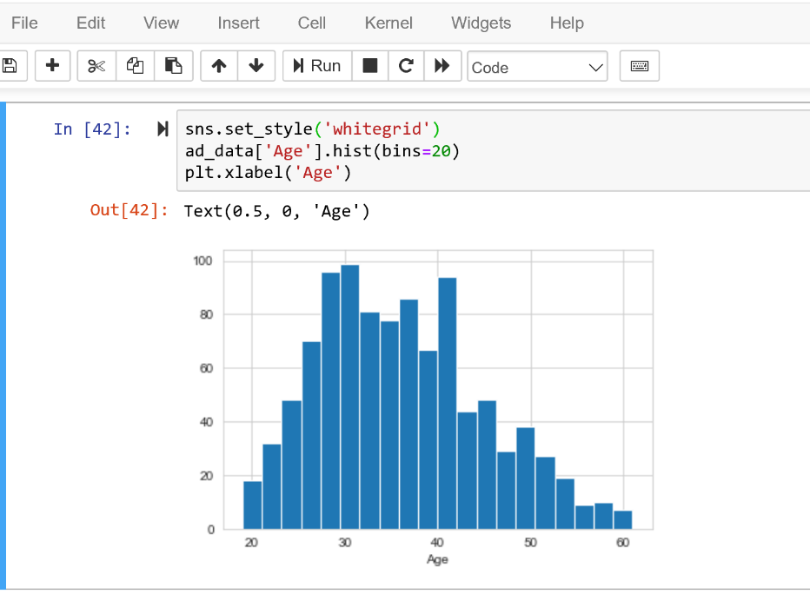
DATA EXPLORATORY Cont’d
We see from the distribution of the data that more of the observations are concentrated in Age 25+ to 40.
We can see from the plot that users started their earnings around Age 20. It appears more users earn more income as their Age increases and decreases as they grow older may due to retirement.

Slide 11
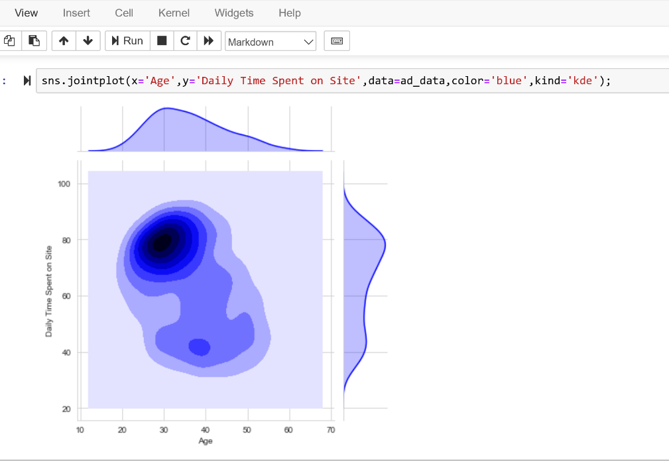
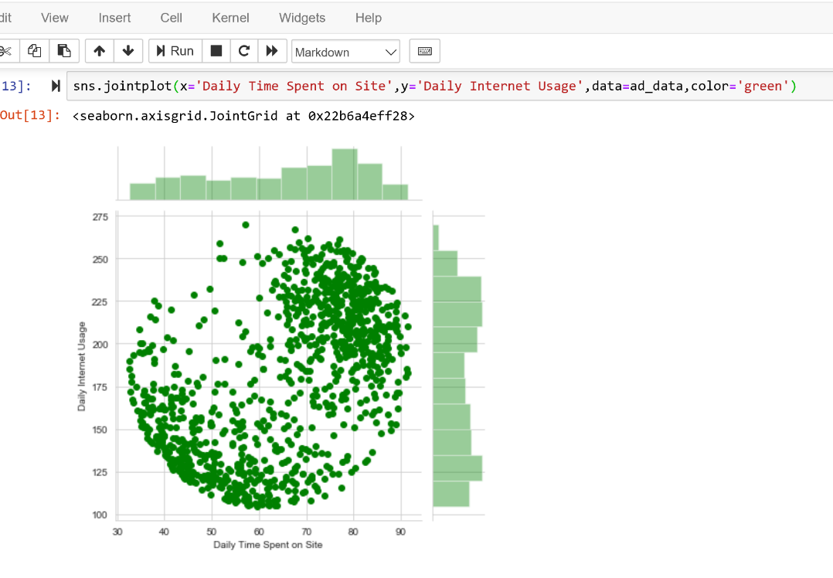
DATA EXPLORATORY Cont’d
The peaks of a Density Plot or KDE(Kernel Density Estimation) plot help display where values are concentrated over the time interval
We noticed as the ‘Daily time Spent on site’ increases and ‘Daily Internet Usage’ also increases, a cluster is formed at the top right of the plot.

Slide 12
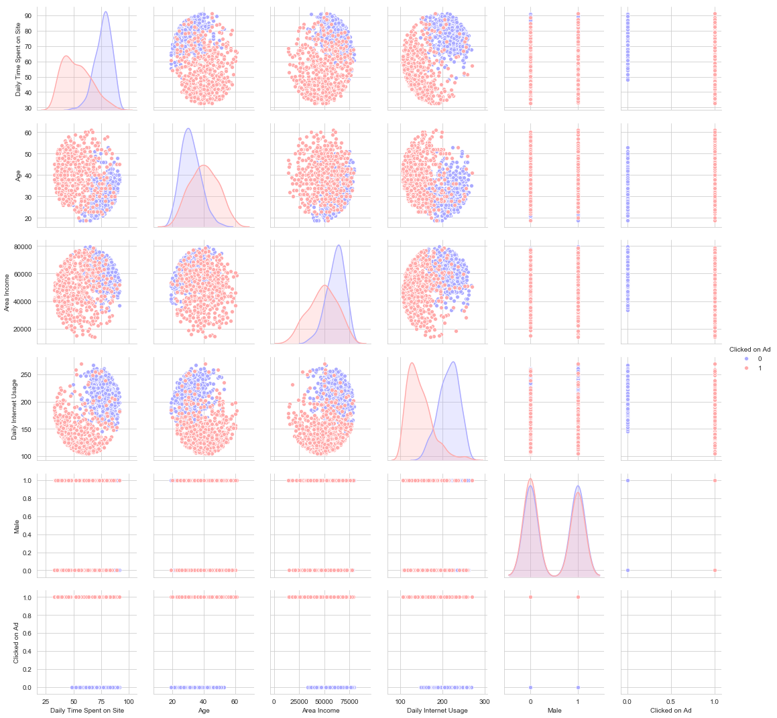
DATA EXPLORATORY Cont’d
Finally, we create a pair-plot with the hue defined by the 'Clicked on Ad' column feature to examine the relationship between each targeted variable against one another.

Slide 13
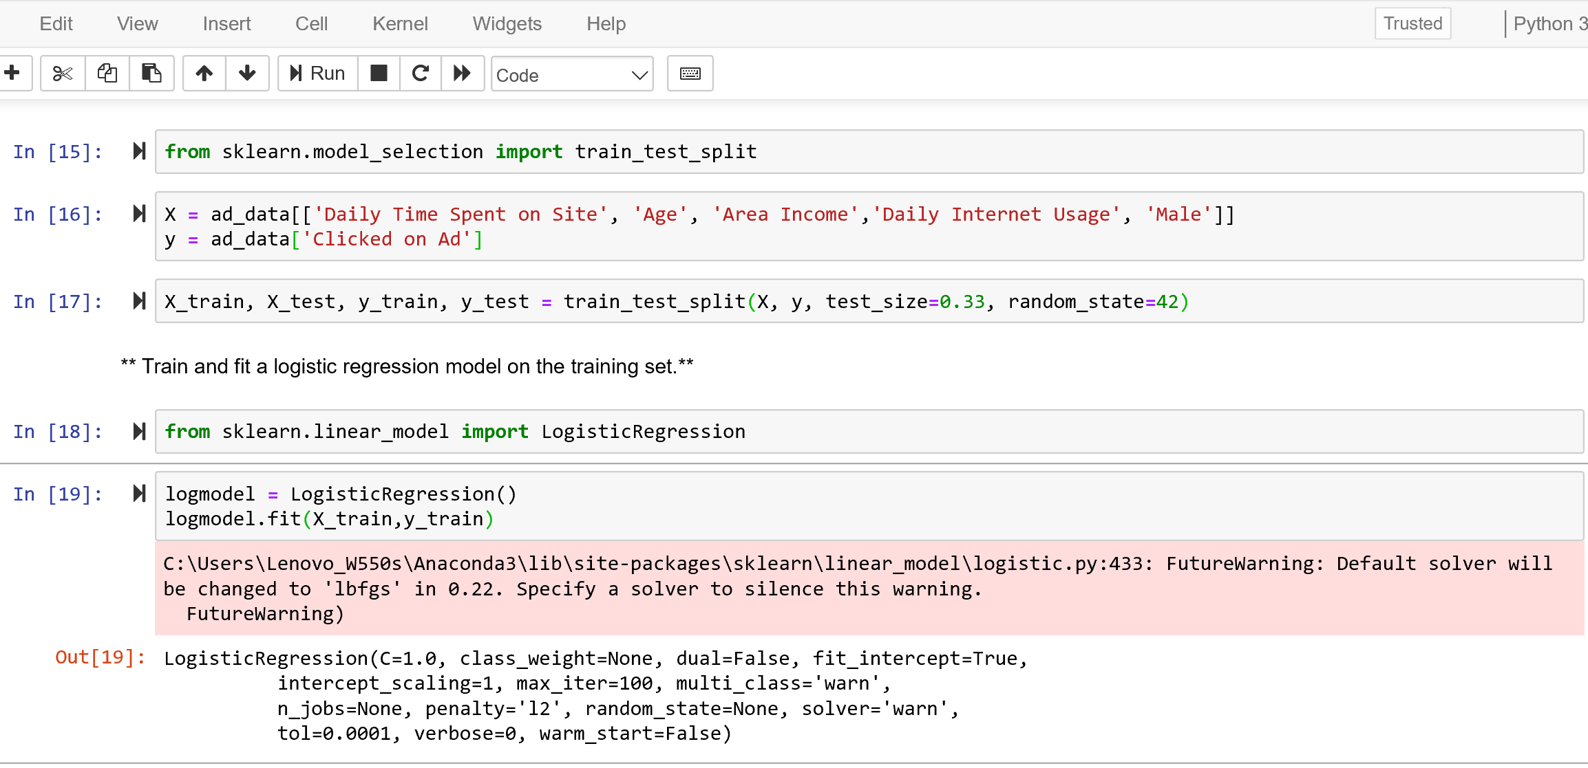
MODEL
The scope our model is limited to integers and float data types, We will drop columns from the data set which data types are text words(strings).
To build our model, we split the observations in the new set of columns in advertising dataset into training set and testing set using train_test_split in the ratio 67:33 with Clicked on Ad as the target variable.

Slide 14
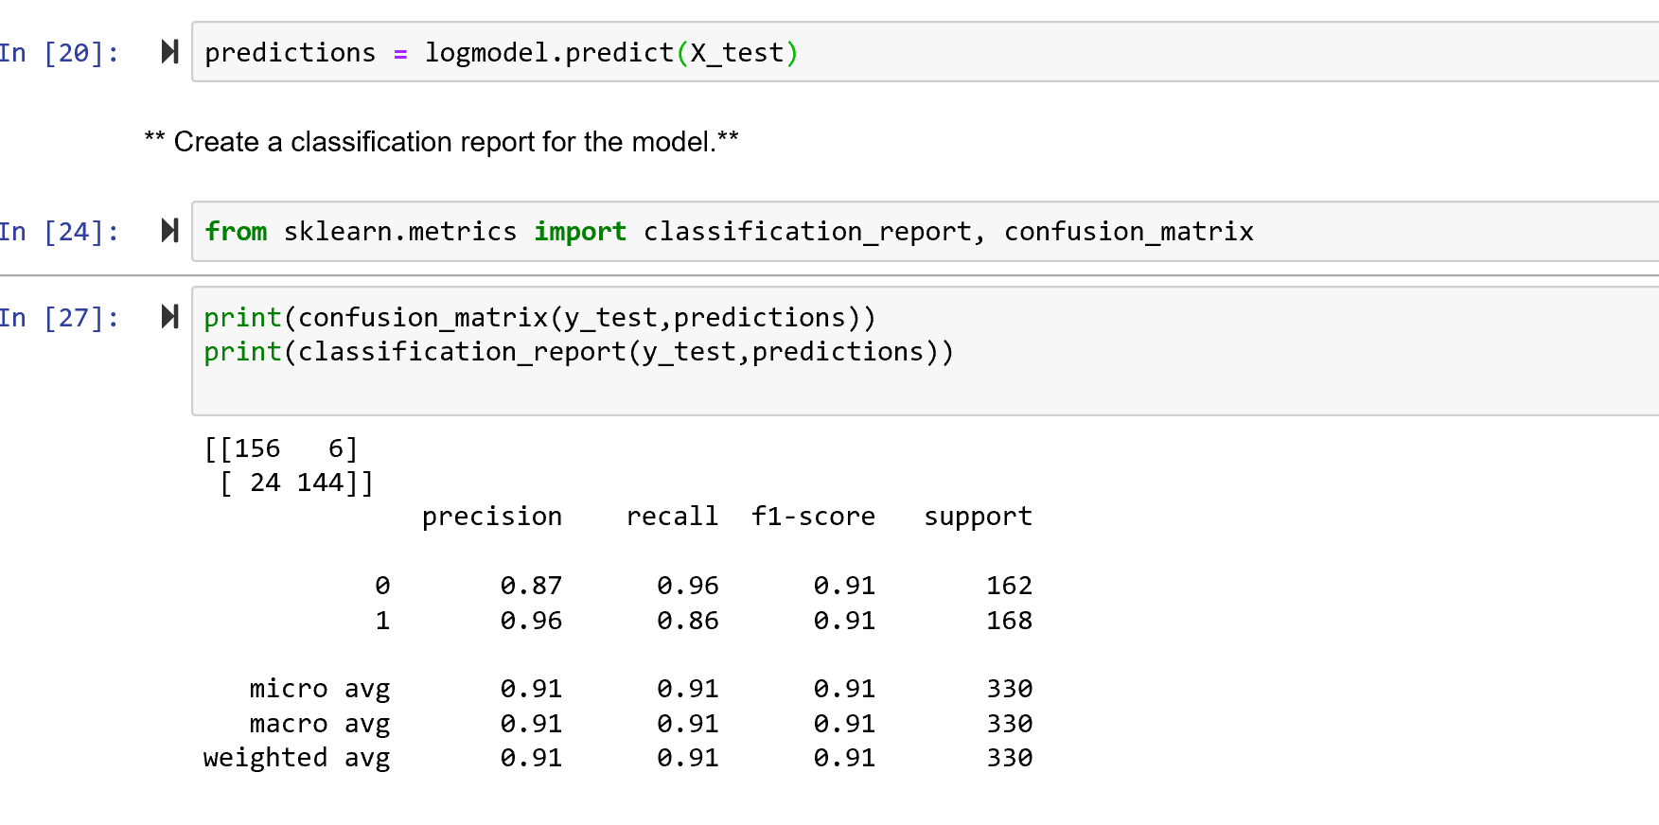

PREDICTIONS AND EVALUATIONS
Accuracy:
$\frac{(TN+TP)}{n}$ = $\frac{156+144}{330}$ = 0.91
Misclassification Rate(Error Rate):
$\frac{(FN+FP)}{n}$ = $\frac{24+6}{330}$ = = 0.09
n = 330 | Predicted: NO | Predicted: YES
Actual: NO | TN= 156 | FP= 6
Actual: YES | FN= 24 | TP= 144

Slide 15
CONCLUSION
Based on the Accuracy(91%) from the confusion matrix, we could conclude that our model would do a proper predictions from our classifications.
The model would be very useful for digital marketers and analysts.

Slide 16

THANK YOU

